Slide 1
William Stallings
Computer Organization and Architecture
6th Edition
Chapter 4
Cache Memory

Slide 2
Characteristics
Location
Capacity
Unit of transfer
Access method
Performance
Physical type
Physical characteristics
Organisation

Slide 3
Location
CPU
Internal
External

Slide 4
Capacity
Word size
  The natural unit of organisation
Number of words
  or Bytes

Slide 5
Unit of Transfer
Internal
  Usually governed by data bus width
External
  Usually a block which is much larger than a word
Addressable unit
  Smallest location which can be uniquely addressed
  Word internally
  Cluster on M$ disks

Slide 6
Access Methods (1)
Sequential
  Start at the beginning and read through in order
  Access time depends on location of data and previous location
  e.g. tape
Direct
  Individual blocks have unique address
  Access is by jumping to vicinity plus sequential search
  Access time depends on location and previous location
  e.g. disk

Slide 7
Access Methods (2)
Random
  Individual addresses identify locations exactly
  Access time is independent of location or previous access
  e.g. RAM
Associative
  Data is located by a comparison with contents of a portion of the store
  Access time is independent of location or previous access
  e.g. cache

Slide 8
Memory Hierarchy
Registers
  In CPU
Internal or Main memory
  May include one or more levels of cache
  “RAM”
External memory
  Backing store

Slide 9

Memory Hierarchy - Diagram

Slide 10
Performance
Access time
  Time between presenting the address and getting the valid data
Memory Cycle time
  Time may be required for the memory to “recover” before next access
  Cycle time is access + recovery
Transfer Rate
  Rate at which data can be moved
  TN(avg time to read/write Nbits) = TA(Avg access time)+ N (number of bits)/R (Tx rate)

Slide 11
Physical Types
Semiconductor
  RAM
Magnetic
  Disk & Tape
Optical
  CD & DVD
Others
  Bubble
  Hologram

Slide 12
Physical Characteristics
Decay
Volatility
Erasable
Power consumption

Slide 13
Organisation
Physical arrangement of bits into words
Not always obvious
e.g. interleaved

Slide 14
The Bottom Line
How much?
  Capacity
How fast?
  Time is money
How expensive?

Slide 15
Hierarchy List
Registers
L1 Cache
L2 Cache
Main memory
Disk cache
Disk
Optical
Tape

Slide 16
So you want fast?
It is possible to build a computer which uses only static RAM (see later)
This would be very fast
This would need no cache
  How can you cache cache?
This would cost a very large amount

Slide 17
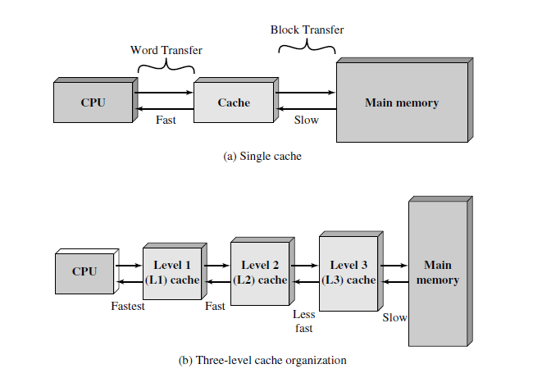
Cache
Small amount of fast memory
Sits between normal main memory and CPU
May be located on CPU chip or module

Slide 18
Cache operation - overview
CPU requests contents of memory location
Check cache for this data
If present, get from cache (fast)
If not present, read required block from main memory to cache
Then deliver from cache to CPU
Cache includes tags to identify which block of main memory is in each cache slot

Slide 19
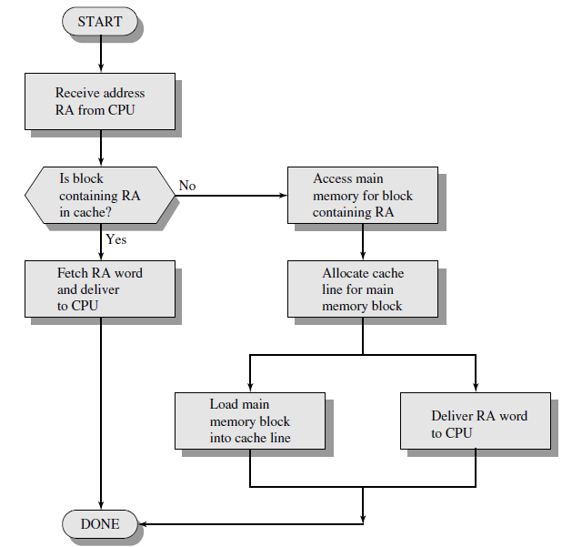

Slide 20
Cache Design
Size
Mapping Function
Replacement Algorithm
Write Policy
Block Size
Number of Caches

Slide 21
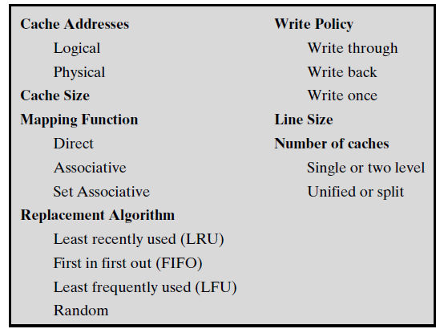
Cache Design

Slide 22
Size does matter
Cost
  More cache is expensive
Speed
  More cache is faster (up to a point)
  Checking cache for data takes time

Slide 23

Typical Cache Organization

Slide 24
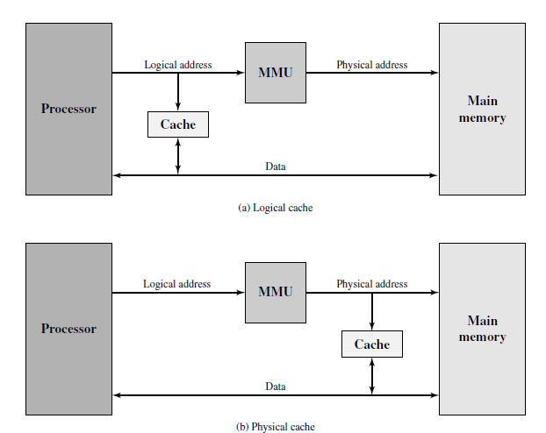
Cache address

Slide 25
Mapping Function
Cache of 64kByte
Cache block of 4 bytes
  i.e. cache is 16k (2¹⁴) lines of 4 bytes
16MBytes main memory
24 bit address
  (2²⁴=16M)

Slide 26
Direct Mapping
Each block of main memory maps to only one cache line
  i.e. if a block is in cache, it must be in one specific place
Address is in two parts
Least Significant w bits identify unique word
Most Significant s bits specify one memory block
The MSBs are split into a cache line field r and a tag of s-r (most significant)

Slide 27
Direct Mapping
Address Structure
Tag s-r
Line or Slot r
Word w
8
14
2
24 bit address
2 bit word identifier (4 byte block)
22 bit block identifier
  8 bit tag (=22-14)
  14 bit slot or line
No two blocks in the same line have the same Tag field
Check contents of cache by finding line and checking Tag

Slide 28
Direct Mapping
Cache Line Table
Cache line Main Memory blocks held
0 0, m, 2m, 3m…2^{s}-m
1 1,m+1, 2m+1…2^{s}-m+1
m-1 m-1, 2m-1,3m-1…2^{s}-1

Slide 29
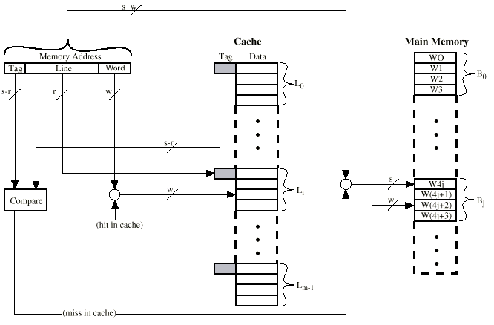
Direct Mapping Cache Organization

Slide 30
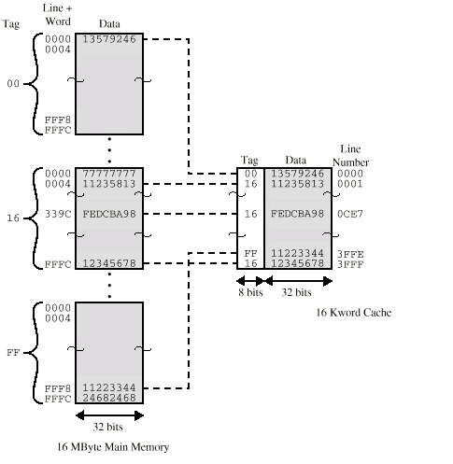
Direct Mapping Example

Slide 31
Direct Mapping Summary
Address length = (s + w) bits
Number of addressable units = 2^{s+w} words or bytes
Block size = line size = 2^{w} words or bytes
Number of blocks in main memory = 2^{s+ w}/2^{w} = 2^{s}
Number of lines in cache = m = 2^{r}
Size of tag = (s – r) bits

Slide 32
Direct Mapping pros & cons
Simple
Inexpensive
Fixed location for given block
  If a program accesses 2 blocks that map to the same line repeatedly, cache misses are very high

Slide 33
Associative Mapping
A main memory block can load into any line of cache
Memory address is interpreted as tag and word
Tag uniquely identifies block of memory
Every line’s tag is examined for a match
Cache searching gets expensive

Slide 34

Fully Associative Cache Organization

Slide 35
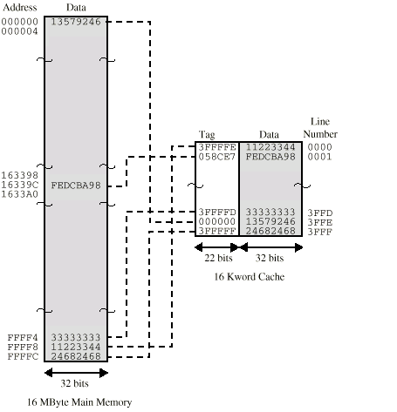
Associative Mapping Example

Slide 36
Associative Mapping
Address Structure
Word
2 bit
Tag 22 bit
22 bit tag stored with each 32 bit block of data
Compare tag field with tag entry in cache to check for hit
Least significant 2 bits of address identify which 16 bit word is required from 32 bit data block
e.g.
  Address Tag Data Cache line
  FFFFFC FFFFFC 24682468 3FFF

Slide 37
Associative Mapping Summary
Address length = (s + w) bits
Number of addressable units = 2^{s+w} words or bytes
Block size = line size = 2^{w} words or bytes
Number of blocks in main memory = 2^{s+ w}/2^{w} = 2^{s}
Number of lines in cache = undetermined
Size of tag = s bits

Slide 38
Set Associative Mapping
Cache is divided into a number of sets
Each set contains a number of lines
A given block maps to any line in a given set
  e.g. Block B can be in any line of set i
e.g. 2 lines per set
  2 way associative mapping
  A given block can be in one of 2 lines in only one set

Slide 39
Set Associative Mapping
Example
13 bit set number
Block number in main memory is modulo 2¹³
000000, 00A000, 00B000, 00C000 … map to same set

Slide 40
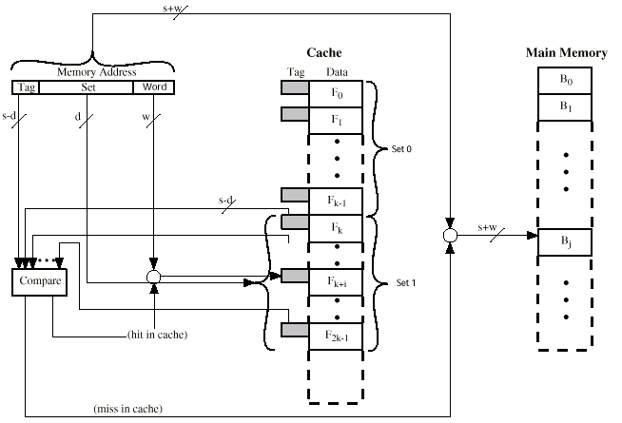
Two Way Set Associative Cache Organization

Slide 41
Set Associative Mapping
Address Structure
Word
2 bit
Tag 9 bit
Set 13 bit
Use set field to determine cache set to look in
Compare tag field to see if we have a hit
e.g
  Address Tag Data Set number
  1FF 7FFC 1FF 12345678 1FFF
  001 7FFC 001 11223344 1FFF

Slide 42
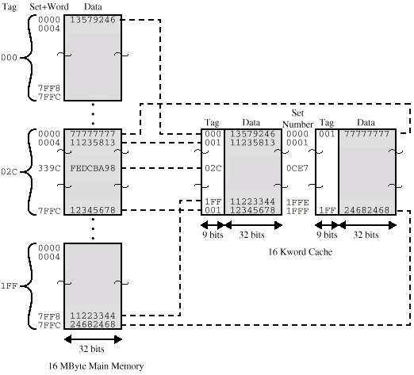
Two Way Set Associative Mapping Example

Slide 43
Set Associative Mapping Summary
Address length = (s + w) bits
Number of addressable units = 2^{s+w} words or bytes
Block size = line size = 2^{w} words or bytes
Number of blocks in main memory = 2^{d}
Number of lines in set = k
Number of sets = v = 2^{d}
Number of lines in cache = kv = k * 2^{d}
Size of tag = (s – d) bits

Slide 44
Replacement Algorithms (1)
Direct mapping
No choice
Each block only maps to one line
Replace that line

Slide 45
Replacement Algorithms (2)
Associative & Set Associative
Hardware implemented algorithm (speed)
Least Recently used (LRU)
e.g. in 2 way set associative
  Which of the 2 block is lru?
First in first out (FIFO)
  replace block that has been in cache longest
Least frequently used
  replace block which has had fewest hits
Random

Slide 46
Write Policy
Must not overwrite a cache block unless main memory is up to date
Multiple CPUs may have individual caches
I/O may address main memory directly

Slide 47
Write through
All writes go to main memory as well as cache
Multiple CPUs can monitor main memory traffic to keep local (to CPU) cache up to date
Lots of traffic
Slows down writes
Remember bogus write through caches!

Slide 48
Write back
Updates initially made in cache only
Update bit for cache slot is set when update occurs
If block is to be replaced, write to main memory only if update bit is set
Other caches get out of sync
I/O must access main memory through cache
N.B. 15% of memory references are writes

Slide 49
Pentium 4 Cache
80386 – no on chip cache
80486 – 8k using 16 byte lines and four way set associative organization
Pentium (all versions) – two on chip L1 caches
  Data & instructions
Pentium 4 – L1 caches
  8k bytes
  64 byte lines
  four way set associative
L2 cache
  Feeding both L1 caches
  256k
  128 byte lines
  8 way set associative

Slide 50
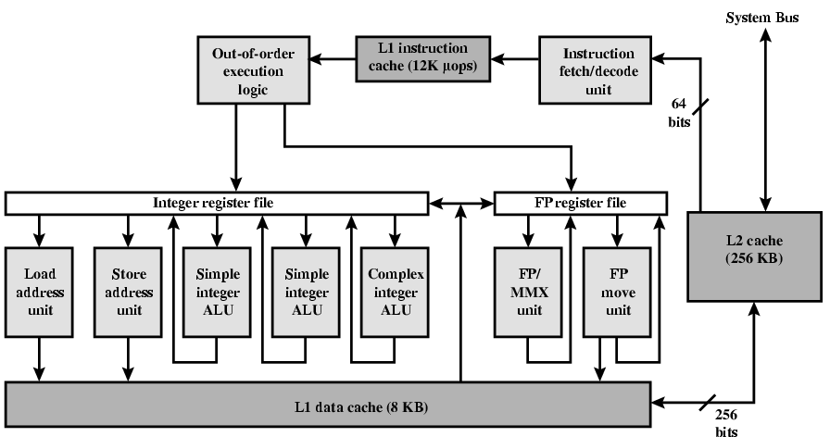
Pentium 4 Diagram (Simplified)

Slide 51
Pentium 4 Core Processor
Fetch/Decode Unit
  Fetches instructions from L2 cache
  Decode into micro-ops
  Store micro-ops in L1 cache
Out of order execution logic
  Schedules micro-ops
  Based on data dependence and resources
  May speculatively execute
Execution units
  Execute micro-ops
  Data from L1 cache
  Results in registers
Memory subsystem
  L2 cache and systems bus

Slide 52
Pentium 4 Design Reasoning
Decodes instructions into RISC like micro-ops before L1 cache
Micro-ops fixed length
  Superscalar pipelining and scheduling
Pentium instructions long & complex
Performance improved by separating decoding from scheduling & pipelining
  (More later – ch14)
Data cache is write back
  Can be configured to write through
L1 cache controlled by 2 bits in register
  CD = cache disable
  NW = not write through
  2 instructions to invalidate (flush) cache and write back then invalidate

Slide 53
Power PC Cache Organization
601 – single 32kb 8 way set associative
603 – 16kb (2 x 8kb) two way set associative
604 – 32kb
610 – 64kb
G3 & G4
  64kb L1 cache
    8 way set associative
  256k, 512k or 1M L2 cache
    two way set associative

Slide 54
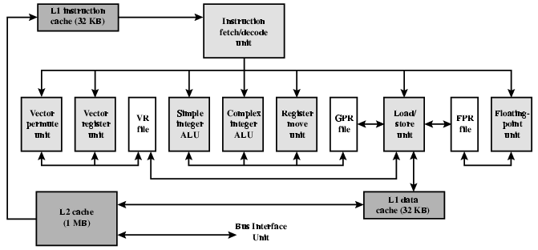
PowerPC G4

Slide 55
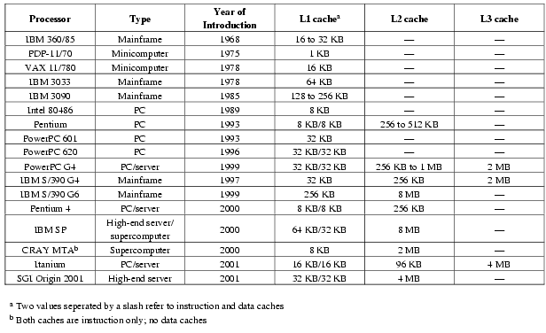
Comparison of Cache Sizes

